Slide 1
Reconnecting New Zealanders
to the world

Slide 2
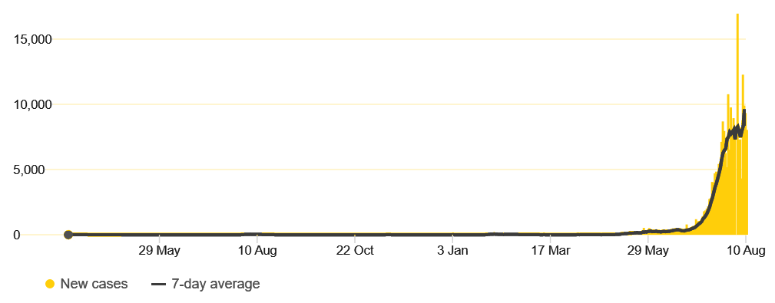
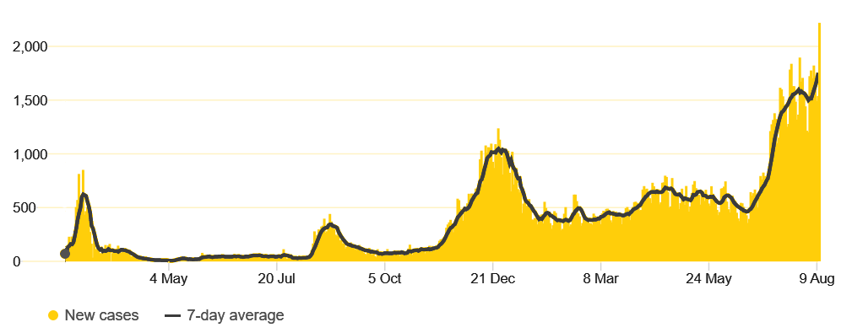
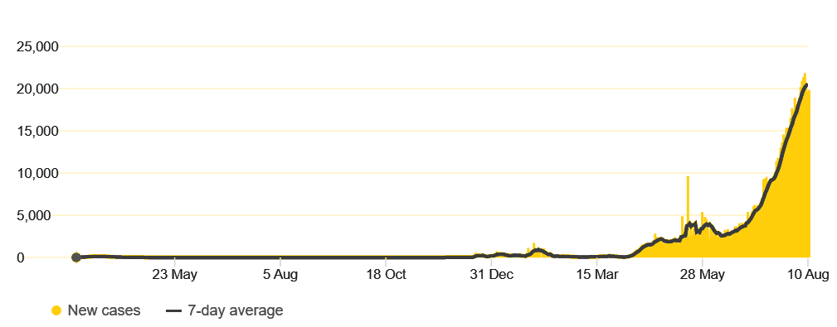
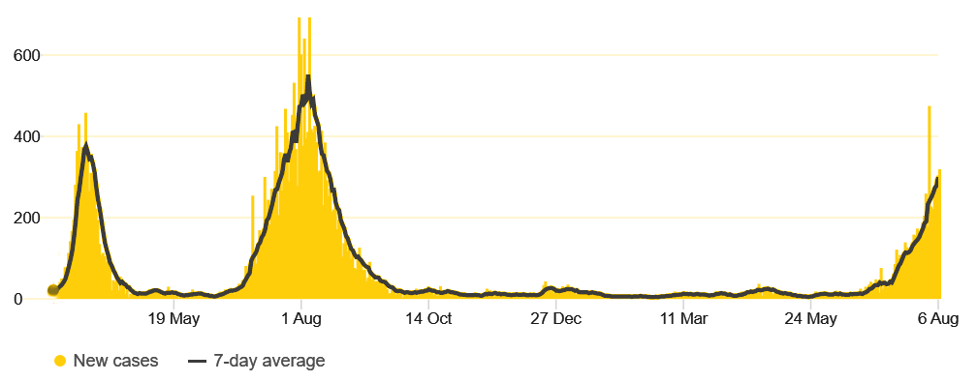
Countries early in their vaccination programmes that had transmission under control before Delta
Vietnam
South Korea
Thailand
Australia

Slide 3
Our strong health response has led to a stronger economy:
Unemployment at 4% (lower than Australia, the US, and Canada)
63,000 more people in jobs since September
Net debt lower than forecast
Export revenue from primary sector forecast to hit record high this year

Slide 4
Principle one
Maintaining our elimination strategy to stamp out the virus and keep our options open

Slide 5
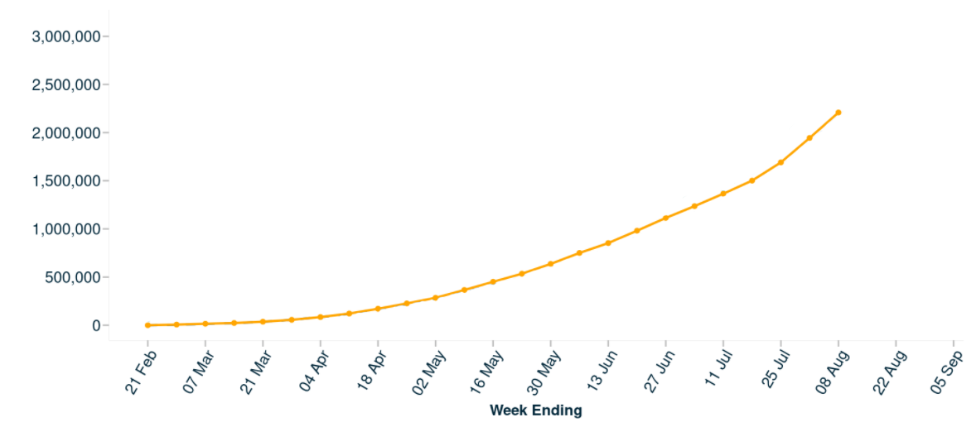
Our vaccine rollout is accelerating:
Cumulative vaccinations
COVID-19: Vaccine data | Ministry of Health NZ

Slide 6
Our vaccine rollout is accelerating:
Age group | Date bookings open
50+ | Friday 13 August
40+ | Wednesday 18 August
30+ | Wednesday 25 August
All ages | Wednesday 1 September

Slide 7
Principle two
Ensuring every eligible New Zealander is offered the opportunity to be vaccinated as soon as possible

Slide 8
Principle three
Reducing the need for further lockdowns as much as possible by continuing to strengthen our health and contact tracing systems

Slide 9
Principle four
Maintaining strong public health tools

Slide 10
Three pathways:
 | Travellers | Requirements
Low risk | Vaccinated Spent past 14 days in a low risk country | Testing requirements, but no isolation
Medium risk | Vaccinated Spent past 14 days in a medium risk country | Testing requirements, modified isolation
High risk | Unvaccinated travellers Vaccinated travellers who have spent the past 14 days in a high risk country | Testing requirements, plus 14 days in MIQ

Slide 11
Principle five
Developing new ways to enable people to travel safely to and from New Zealand

Slide 12
Reconnecting New Zealanders to the world: Next steps

