Slide 1



Te Rūnanga o Whaingaroa
Living with Omicron
Learnings from Wainui Marae
January 2022

Slide 2

Te Rūnanga o Whaingaroa
Continue to prioritise the six focus areas
Hauora - Coordinated health response across the Whangaroa Hauora collective. Working with PHU and NDHB through the Mid North Hub (TRoW, THON, Hokianga Health)
Kai - Access to kai support for whānau who have returned a positive COVID-19 result, kai packages for whānau who are having to isolate at home,
Mental Wellbeing - Supporting Whānau to deescalate anxieties, promote wellbeing and provide support during distressing and exhausting time for Whānau.
Housing - Isolation measures and accommodations for those who need to isolate. Existing TA Cabins available as well as Iwi allocated Campervans.
Communications - Coordinating communications across Ngā Whānuku o Whangaroa including social media updates. Clear communications as to where whānau can seek support.
Border management - Supporting Road and marine checkpoints to keep our valleys and bays and communities safe, monitoring traffic levels in and out of the rohe, communicating these vents.

Slide 3
COVID Team
Management/Leads
Operations and Logistics Lead: Bree Davis
Logistics/Whānau Support: Tracey Pomare, Kath Keremete
Administration/Finance: Marlene Pivac, Vivian Taka
Communications: Raniera Kaio, Debbie Jepson
The management team are responsible to drive the COVID-19 Plan. They are also responsible to ensure that staff are supported during the activation of the Plan. Management can co-opt other staff members and/or community members to support the activation of any lead tasks.
Hauora Team
Lead Nurse – Lorna Smeath
Nurse– Janine Whyte
Nurses Admin - Doris Pilcher and Paige Hikuwai
The Hauora team are the key enablers for whānau to access testing, vaccination and/or other necessary health support required. This may include working alongside other hauora providers to deliver health care support into Whangaroa.

Slide 4
So, what did we learn?

Slide 5
The Kumara vine is faster than the system
TRoW is a part of the Mid North Hub (TRoW, THON, Hokianga Health)
  Connected into the DHB and the tracing team
Collaboration
  An email to TRoW CEO resulted in fast connection with Wainui Marae
  Clear contact person at the Marae
  NDHB, TRoW and Marae can be dynamic working together
Quick communications work
  They need to be clear
  They need to be correct/factual/accurate

Slide 6
Contact Classification and Testing regime
Positive Case https://covid19.govt.nz/isolation-and-care/if-you-test-positive-for-covid-19/
Close contact https://covid19.govt.nz/testing-and-tracing/contact-tracing/close-contacts/#who-is-a-close-contact
Casual contact https://covid19.govt.nz/testing-and-tracing/contact-tracing/casual-contacts/
Secondary contact https://covid19.govt.nz/testing-and-tracing/contact-tracing/close-contacts/#secondary-contacts-%E2%80%94-if-you-live-with-a-close-contact

Slide 7
Clunky system
There are delays when positive cases are uncontactable
Contact tracing and investigations
Government only has access to scanned data
Alerts sent to phones happen after the investigation
Locations of interests are public locations
Testing stations need to be quick and responsive
TRoW does not know who close contacts are unless whānau tell us
Notes:
Need to be done before DHB can determine level of “seriousness”

Slide 8
Even with the best practices, it can still happen.
We need to educate whānau to stay home if they are unwell and have had a test
Marae should adopt their own contact tracing sheet as this helps to speed up the process to reach out to whānau
Marae would benefit from having clear pandemic plans and a key contact for TRoW to connect with
Marae should have the necessary masks/sanitisers
We could all do with being clear on the processes

Slide 9
What can TRoW do?
Positive case
Close contacts
Kai packages
Health packages (sanitizers etc)
Wellbeing phone calls
Isolation support – Campervans if required
Clinical support from NDHB
Kai packages
Wellbeing phone calls
Health packages (sanitisers etc)

Slide 10
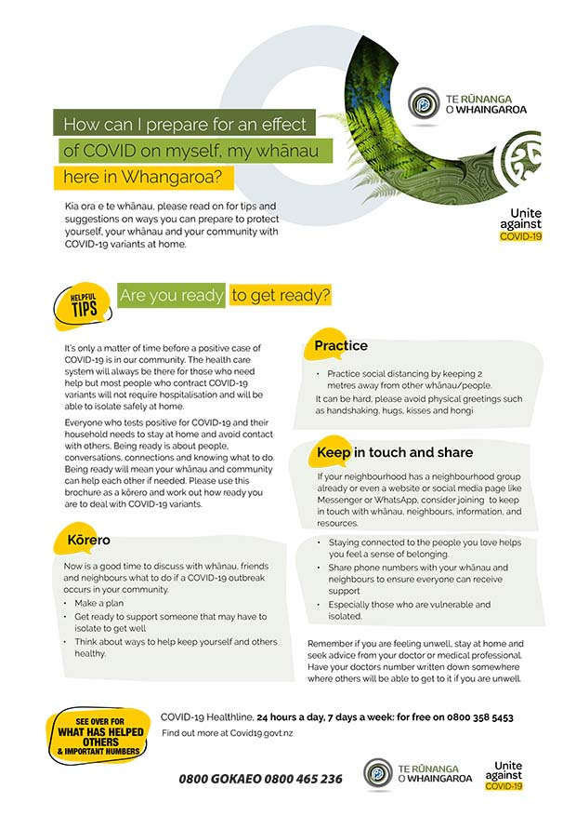
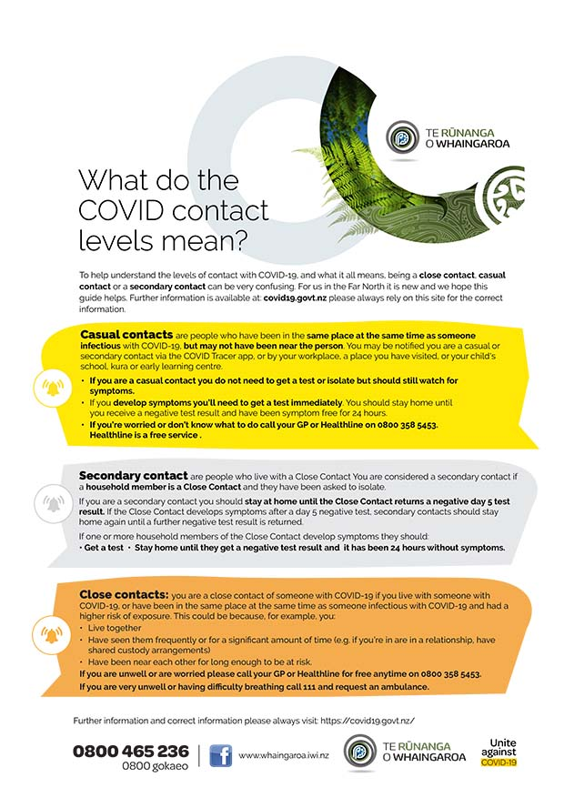
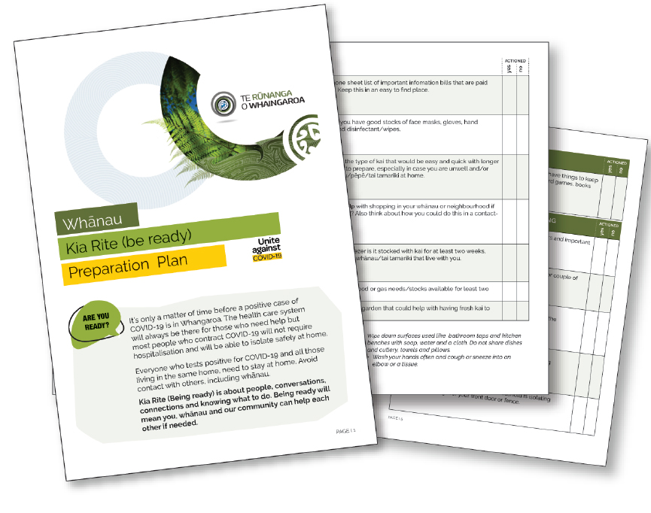
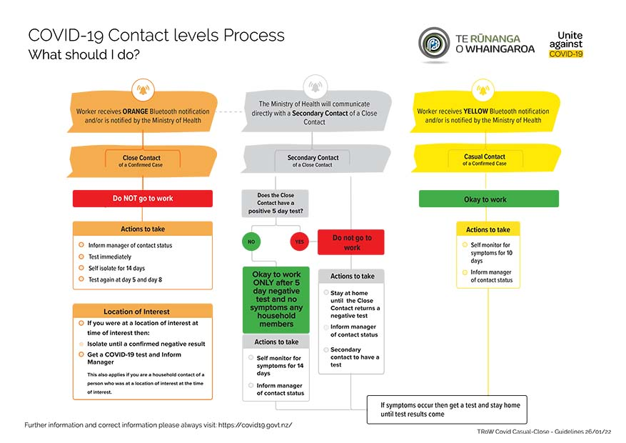
TRoW continues to…
Produce and supply COVID resources
That inform, unbiased, truthful, whānau centred and Whangaroa focused.
January 2022 availability
Handouts
Vaccination sites, offices and staff
Registered whanau email mailouts
Facebook
Website
Downloads available from
https://whaingaroa.iwi.nz/
Whānau Kia Rite Preparation plan template/booklet
Whānau Kia Rite Preparation tips
What do the COVID contact levels mean

Slide 11
Where to from here?
Collectivised approach is necessary
Whanuku roopu will be invaluable to stay connected
Clear communications to be placed on TRoW Facebook for sharing
Support one another to live with Omicron in the community
What have we missed?

