Slide 1
Resource management reforms and upholding the Ngatikahu ki Whangaroa
Treaty settlement

Slide 2
Presentation sections
Overview of resource management reforms
Upholding statutory acknowledgements
Legislation timeframes, transition and next steps

Slide 3
Overview of resource management reforms

Slide 4
New legislation
The Resource Management Act (1991) will be repealed, and new legislation enacted:
Spatial Planning Act
Natural and Built Environments Act
Climate Adaptation Act
Notes:
TPE / EMWaR under Joint Committees

Slide 5
Some key changes in the new system
Governance roles in every region across all resource management areas.
Treaty clause – requires giving effect to the principles of Te Tiriti o Waitangi.
A te ao Māori concept at the heart of legislation – Te Oranga o te Taiao.
Proactive monitoring of Treaty performance by a national entity, that doesn’t require a claim to the Waitangi Tribunal.
National Planning Framework that in process and substance gives effect to the principles of Te Tiriti, and reflects te ao Māori, including mātauranga Māori.

Slide 6
Comparison with the RMA system

Slide 7
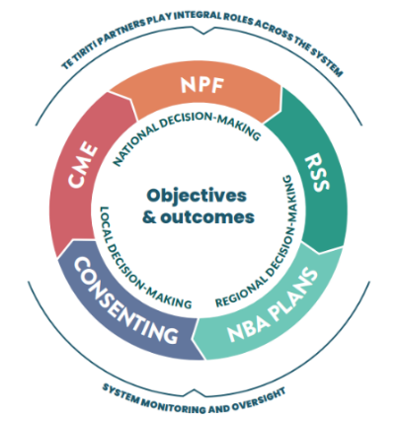
Plan making in the new system
In the new system:
regional councils will no longer be responsible for the preparation of regional policy statements and regional plans
district councils will no longer be responsible for the preparation of district plans.
These roles will fall to a new regional planning committee.
There will only be two planning documents for the regional planning committee:
a Natural and Built Environment Act plan
a regional spatial strategy.

Slide 8
Regional planning committees (RPC)
Minimum of six members on each committee (but no maximum)
A minimum of two members to represent hapū and iwi
Other members will represent local authorities (and central government in the case of regional spatial strategies).
Local authorities and iwi/hapū in a region have to agree on the composition of the RPC for a region including how many iwi/hapū members there will be.
Hapū and iwi to agree appointing bodies for the hapū and iwi members on the RPC.
If hapū iwi can’t reach agreement on appointing bodies then parties will be referred to Māori Land Court mediation, and if that fails, will be determined by an expert panel.

Slide 9
Regional spatial strategies
Regional spatial strategies deliver strategic decisions around land and resource use, infrastructure and funding.
Content will reflect regional circumstances:​​
areas to protect or enhance​
areas subject to constraints (e.g. natural hazards)​
areas appropriate for development ​​
areas where significant land use change is required (e.g. to comply with limits)​
indicative locations for future infrastructure corridors and strategic sites.​
Regional strategic direction informed by a new National Planning Framework, evidence, including mātauranga Māori, and community input.

Slide 10
Natural and Built Environment Act plans (NBA plans)
One NBA plan will be developed for each region by regional planning committees.
Intended to bring efficiencies into the system by providing consistency across a region.
NBA plans will replace district and regional plans.
NBA plans will and incorporate the outcomes, limits and targets set through the new National Planning Framework.
Consent activity classes and notification rules will be standardised, with key requirements set out in NBA plans rather than assessed on a case-by-case basis.

Slide 11
Upholding statutory acknowledgements

Slide 12
Statutory acknowledgements – current statutory link to the RMA
A council must have regard to the statutory acknowledgement when deciding whether the iwi is an 'affected person' for the purposes of notification decisions under the RMA. The same applies to the Environment Court when considering participation in hearings under s274 of the RMA.
A council must attach information relating to the statutory acknowledgement to a regional policy statement, regional plan and district plan under the RMA.
A council must send summaries of applications for resource consents to the iwi (for a period of 20 years).

Slide 13
Statutory acknowledgements in the new resource management system
Current provisions re RMA processes will be continued under the new system
Statutory acknowledgments will be referenced in the NBA outcomes clause that provides for the relationship of iwi and hapū with their ancestral lands, water, sites, wāhi tapu, wāhi tupuna and other taonga.
There will be an additional obligation on RPCs to have regard to statutory acknowledgements:
when setting activity status (e.g. permitted activity status) and notification requirements in NBA plans
when preparing Regional Spatial Strategies.

Slide 14
Legislation timeframes, transition and next steps

Slide 15
Amending Ngatikahu ki Whangaroa Claims Settlement Act
To uphold redress affected by the resource management reforms, the Ngatikahu ki Whangaroa Claims Settlement Act 2017 will need to be amended.
The RMA provisions will need to be unbolted and new provisions added to link to the Spatial Planning Act and the Natural and Built Environment Act.
The Spatial Planning Act and the Natural and Built Environment Act need to be enacted first, in order that the appropriate amendments can then be made to your Settlement Act.
The Ngatikahu ki Whangaroa Claims Settlement Act can only be amended with your agreement.

Slide 16
Transition to the new system
Once new legislation is in place it will take some time for the new regime to apply.
Until then the existing RMA instruments will apply.
RMA plans and policy statements will remain in effect until the regional spatial strategy and NBA plan for a region is operative.

Slide 17
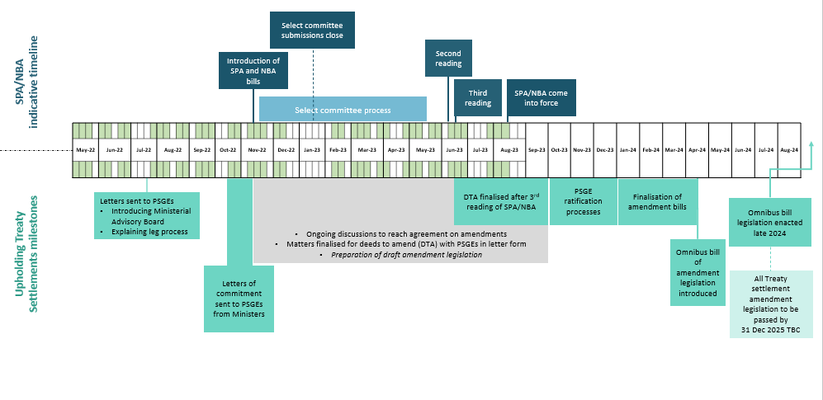
Draft indicative resource management reform legislation timeframe

Slide 18
He mihi – thank you

